Slide 1
BOY SCOUTS OF AMERICA

Slide 2
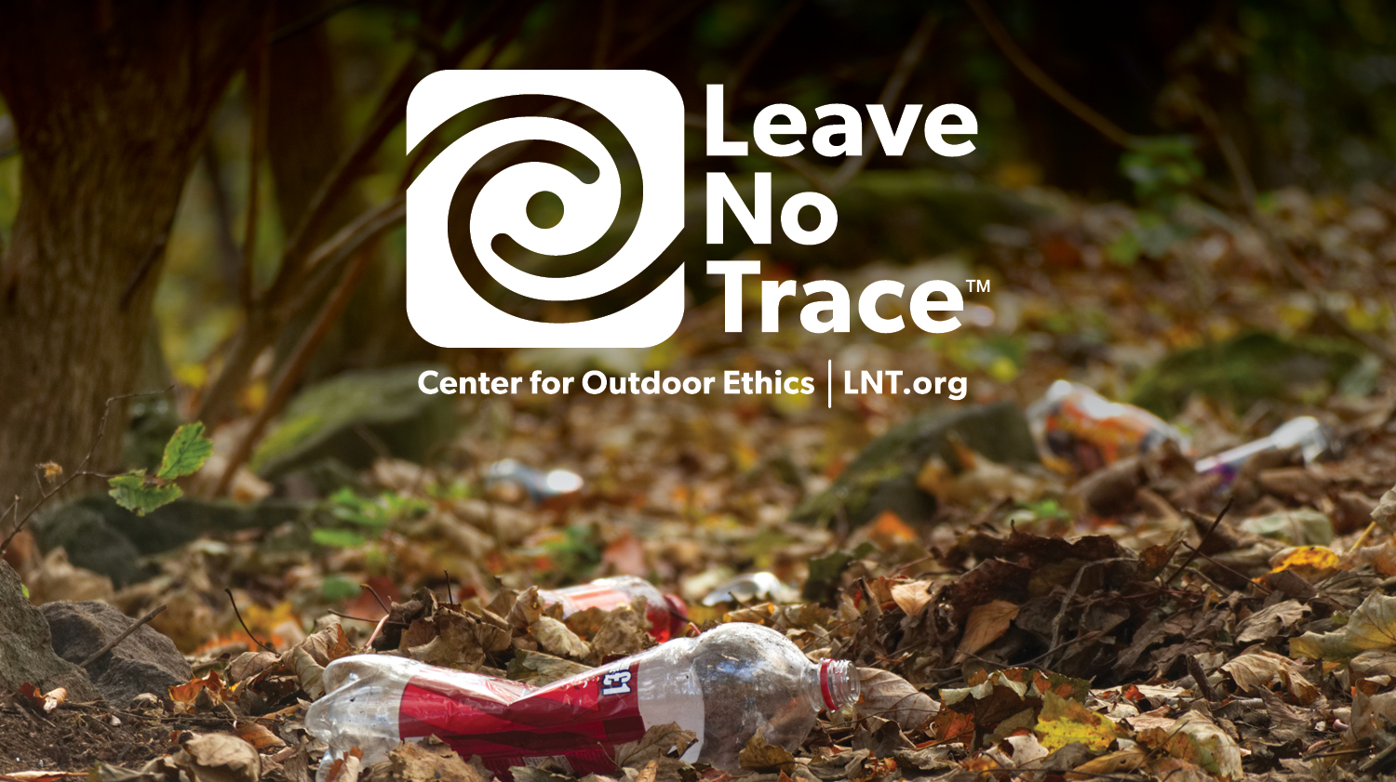
Notes:
How many of you have taken a hike? Been on a picnic? Gone camping with your family or friends? Show of hands. Getting outside renews our spirits, connects us with nature, amazing beauty, and the many natural wonders of our world.
National movement, run by a nonprofit organization (called the Leave No Trace Center for Outdoor Ethics) that is dedicated to protecting the outdoors by teaching and inspiring people to enjoy it responsibly.
Center accomplishes this mission by delivering cutting-edge education, and training programs to millions of people across the country every year.
Then introduce yourselves:
State Advocate/Volunteer/Educator: Introduce yourself and your role with the Leave No Trace Center for Outdoor Ethics.
Leave No Trace addresses impacts and provides people with techniques and skills to enjoy the outdoors sustainably—now and into the future.

Slide 3
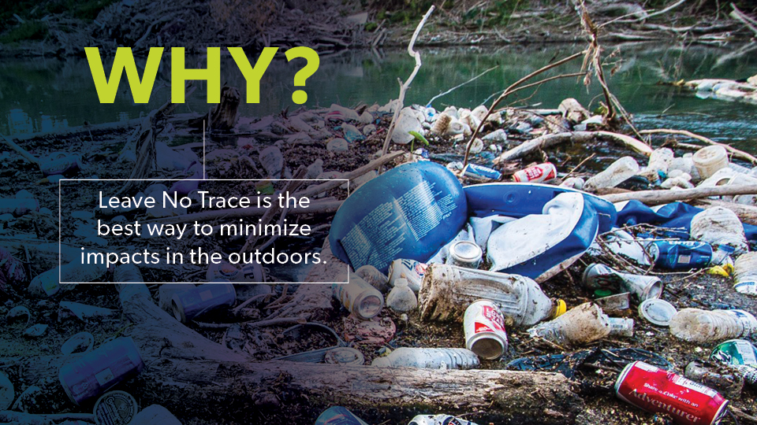
Notes:
9 out of 10 people who visit the outdoors are not informed about Leave No Trace. With over 13 billion trips into the outdoors in the U.S. alone every year, people are causing much preventable damage, and that damage is adding up.
Have you ever seen a trashed area? Fire scars at a campground? Severely damaged trails? Other impacts? Would you believe (use any of stats that may resonate):
Americans pay $2.9 billion to fight fires in parks and forests, 80% of which are caused by campfires left unattended, the burning of debris, or negligently discarded cigarettes.
Wildlife in our parks are routinely relocated and, in some cases euthanized, due to conflicts with humans. The National Park Service cites human garbage as the origin of many of these unfortunate and unnecessary conflicts.
Grand Canyon National Park has $11 million in trail maintenance needs and more than $5 million in critical trail work is needed at Great Smoky Mountains National Park.
Each year, tons of petrified wood are removed illegally from Arizona’s Petrified Forest National Park.
Wildlife that obtain human food can lose their fear of humans and develop attraction behaviors to trails, picnic areas, campsites and visitors, turning wild animals into aggressive and potentially dangerous panhandlers. Such animals may ultimately euthanized by land managers because of the risks they present to people.
Invasive species are being spread nationwide due to moving firewood from one area to the next by campers. Many new infestations of non-native tree-killing insects and disease are often first found in campgrounds. The specific insects and diseases vary by region, but some have already killed millions of trees over thousands of acres.
Trash lasts a very long time: plastic grocery bags can last up to 20 years; aluminum cans up to 100 years; fishing line up to 600 years.
According to the U.S. Centers for Disease Control (CDC), one day’s pet waste can contain several billion fecal coliform bacteria, along with Giardia and the eggs of roundworms, hookworms, and tapeworms.
Studies have attributed pet wastes to instances of water pollution sufficient enough to exceed water quality standards, close beaches and harm wildlife.
Recovery rates for areas impacted by recreation are often very slow, with restoration to natural conditions often requiring a minimum of 10-30 years.
Leave No Trace is the best way to minimize these and other types of impacts we see in the outdoors today.
You can be on the forefront of changing that troubling trend—the trashed parks and damaged trails, the formidable impacts of fire, polluted waterways and serious wildlife issues. Now, more than ever, your role is critical.

Slide 4
Notes:
When venturing in the outdoors, humans generally impact the environment in seven broad areas:
Wildlife Impacts: disturbance, altered behavior, intentional or inadvertent feeding, or reduced health and reproduction of animals.
Soil Impacts: loss of organic litter, soil compaction, or soil erosion

Slide 5
Notes:
Vegetation Impacts: vegetation loss, the introduction of invasive species, and tree or plant damage
Cultural Resource Impacts through theft or damage to cultural and historic features and artifacts
Campfire Impacts: large damaging fires, depleting areas of all dead and downed wood, burned trash and food, wildfire risk

Slide 6
Notes:
Water Resource Impacts: siltation, sedimentation, trash, and soap or fecal waste
Social Impacts from Other Visitors: crowding, conflicts between various user groups, and diminished outdoor experience

Slide 7
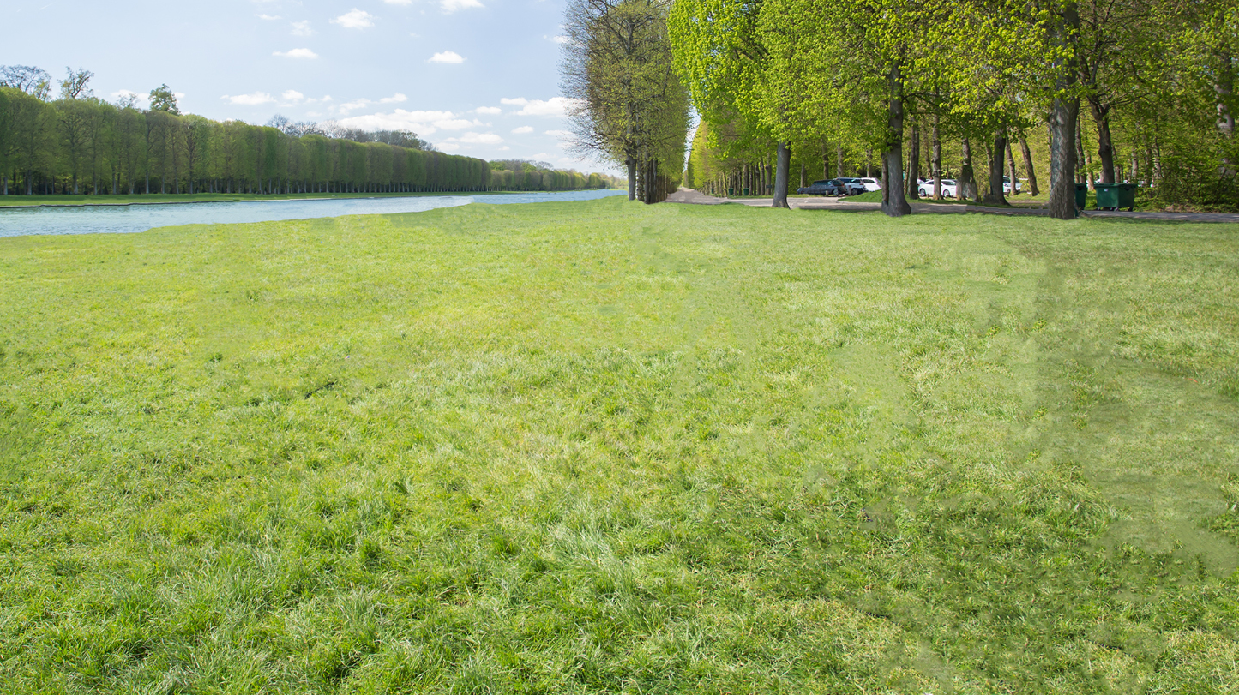
Notes:
Here is a typical park scene. A nice park with grassy fields, a hardened parking area, and easy access to the water.

Slide 8
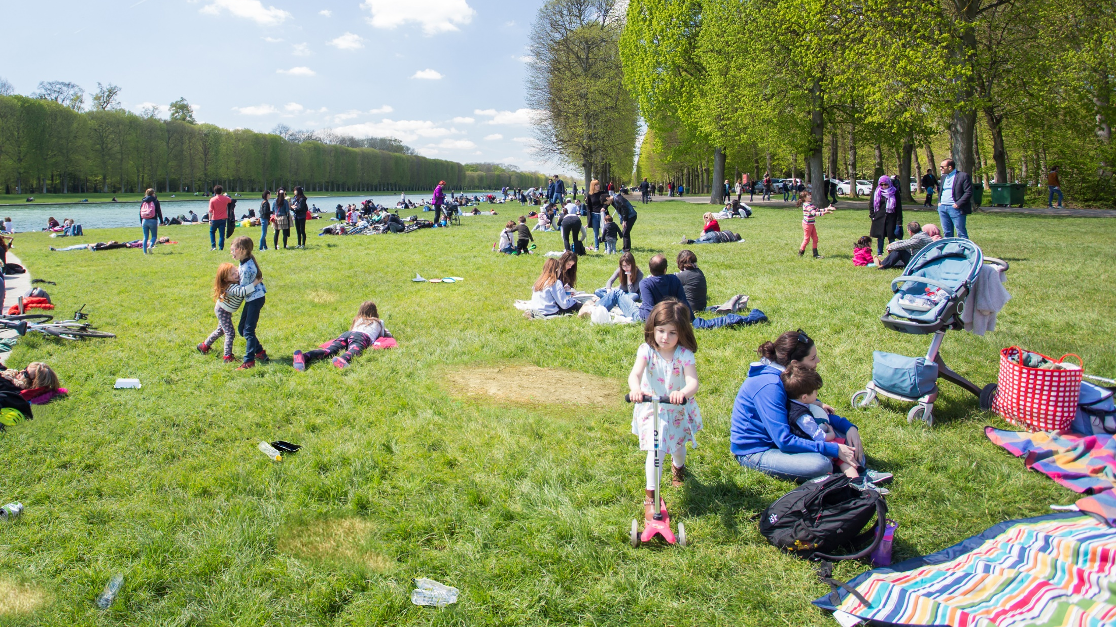
Notes:
Think what happens when even more people come to the park. The potential for recreation-related impacts can increase significantly.

Slide 9
THE OUTDOOR CODE
As a cub scout, I will do my best to -
Be clean in my outdoor manners,
Be careful with fire,
Be considerate in the outdoors, and
Be conservation minded

Slide 10
LEAVE NO TRACE™ Pledge for Kids
Plan Ahead and Prepare
Travel and Camp on Durable Surfaces
Dispose of Waste Properly
Leave What You Find
Minimize Campfire Impacts
Respect Wildlife
Be Considerate of Other Visitors

Slide 11
1. Plan Ahead and Prepare
Know the regulations and special concerns for the area you'll visit.
Prepare for extreme weather, hazards, and emergencies.
Schedule your trip to avoid times of high use.
Visit in small groups when possible. Consider splitting larger groups into smaller groups.
Repackage food to minimize waste.
Use a map and compass to eliminate the use of marking paint, rock cairns or flagging.

Slide 12
2. Travel and Camp on Durable Surfaces
Durable surfaces include established trails and campsites, rock, gravel, dry grasses or snow.
Protect riparian areas by camping at least 200 feet from lakes and streams.
Good campsites are found, not made. Altering a site is not necessary.
In popular areas:
Concentrate use on existing trails and campsites.
Walk single file in the middle of the trail, even when wet or muddy.
Keep campsites small. Focus activity in areas where vegetation is absent.
In pristine areas:
Disperse use to prevent the creation of campsites and trails.
Avoid places where impacts are just beginning.

Slide 13
3. Dispose of Waste Properly
Pack it in, pack it out. Inspect your campsite and rest areas for trash or spilled foods. Pack out all trash, leftover food and litter.
Deposit solid human waste in catholes dug 6 to 8 inches deep, at least 200 feet from water, camp and trails. Cover and disguise the cathole when finished.
Pack out toilet paper and hygiene products.
To wash yourself or your dishes, carry water 200 feet away from streams or lakes and use small amounts of biodegradable soap. Scatter strained dishwater.

Slide 14
4. Leave What You Find
Preserve the past: examine, but do not touch cultural or historic structures and artifacts.
Leave rocks, plants and other natural objects as you find them.
Avoid introducing or transporting non-native species.
Do not build structures, furniture, or dig trenches.

Slide 15
5. Minimize Campfire Impacts
Campfires can cause lasting impacts to the backcountry. Use a lightweight stove for cooking and enjoy a candle lantern for light.
Where fires are permitted, use established fire rings, fire pans, or mound fires.
Keep fires small. Only use sticks from the ground that can be broken by hand.
Burn all wood and coals to ash, put out campfires completely, then scatter cool ashes.

Slide 16
6. Respect Wildlife
Observe wildlife from a distance. Do not follow or approach them.
Never feed animals. Feeding wildlife damages their health, alters natural behaviors, and exposes them to predators and other dangers.
Protect wildlife and your food by storing rations and trash securely.
Control pets at all times, or leave them at home.
Avoid wildlife during sensitive times: mating, nesting, raising young, or winter.

Slide 17
7. Be Considerate of Other Visitors
Respect other visitors and protect the quality of their experience.
Be courteous. Yield to other users on the trail.
Step to the downhill side of the trail when encountering pack stock.
Take breaks and camp away from trails and other visitors.
Let nature's sounds prevail. Avoid loud voices and noises.

Slide 18
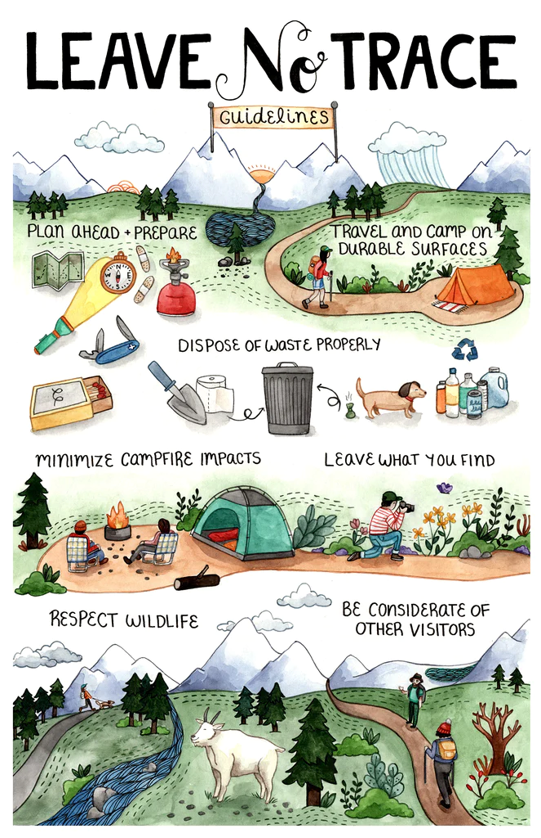
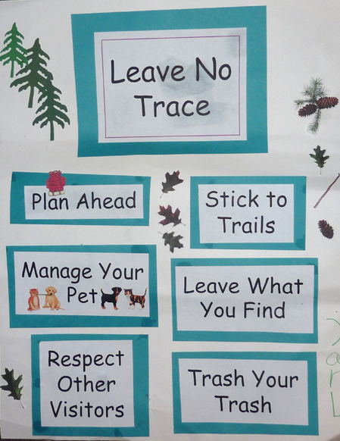
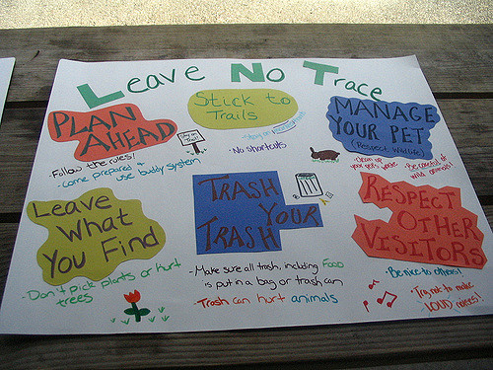

Slide 19
Tiger
Tigers in the Wild

Slide 20
Wolf
Call of the Wild
Paws on the Path

Slide 21
Bear
Fur, Feathers, and Ferns

Slide 22
Webelos
Webelos Walkabout (3 mile hike)

Slide 23
Arrow of Light
Outdoor Adventurer
Scouting Adventure

Slide 24
Guiding Meaningful and Life-Changing Service Projects
“Careful planning allows Scout leaders and resource managers to shape projects that will be satisfying to Scouts, of value to the environment, and matched to the skills of everyone involved.”
“Volunteer conservation projects should not be used as a dumping ground for tasks with little meaning that nobody else wants to do.”
Robert Birkby. The Conservation Handbook, 2nd Edition.
© 2016. Boy Scouts of America.

Slide 25
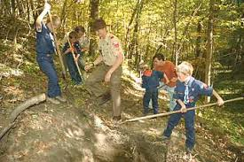
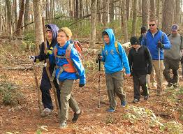
Image Sources: Scouting Magazine
Notes:
The ultimate goal of the Center, which is Leave No Trace education for everyone who loves the outdoors, is enormous. The fastest way to get there, we believe, is to focus on the sources—the lands themselves, as well as youth. The Center focuses on two major initiatives: Leave No Trace in Every Park and Leave No Trace for Every Kid:
Leave No Trace in Every Park focuses on public lands including local, state, and national parks, forests, and protected areas.
Leave No Trace for Every Kid focuses on introducing basic Leave No Trace concepts to kids while they are forming their personal ethic framework.
To ensure that to ensure that Leave No Trace is reaching communities across the country.
we’re also:
training the public
building a vast volunteer network
conducting critical research

Slide 26
